Slide 1
Understanding Physician stress working as a frontline worker during COVID pandemic
Prasangsha Ganguly, Dr.Sayanti Mukherjee and
Abinesh Senthil Kumar

Slide 2

COVID19
Coronavirus disease 2019 (COVID-19) is an infectious disease caused by severe acute respiratory syndrome coronavirus 2 (SARS-CoV-2).
It was first identified in December 2019 in Wuhan, Hubei, China, and has resulted in an ongoing pandemic.

Slide 3
COVID19
Almost everyone’s life in the planet has been impacted by COVID19 either directly or indirectly.
We have changed our way of living to combat the pandemic
This undoubtedly put a lot of stress and uneasiness among the masses.

Slide 4
COVID19
Healthcare facilities in the country has been operating in full capacity since the outbreak to combat the increase in the number of patients.
Undoubtedly the healthcare workers are the ones who are severely impacted by the pandemic.
They are the people who put their lives on the line to serve patients.

Slide 5
STUDY
This study aims to understand how the mental health has been impacted for the healthcare workers working as a frontline worker.
The dataset is a survey data collected on behalf of American Medical Association (AMA).
The survey has more than 200 questions and it had been sent out to top 18 states that has the highest infection count in USA.
We received response from ~1200 people which accounted for (~1.2% response rate)

Slide 6
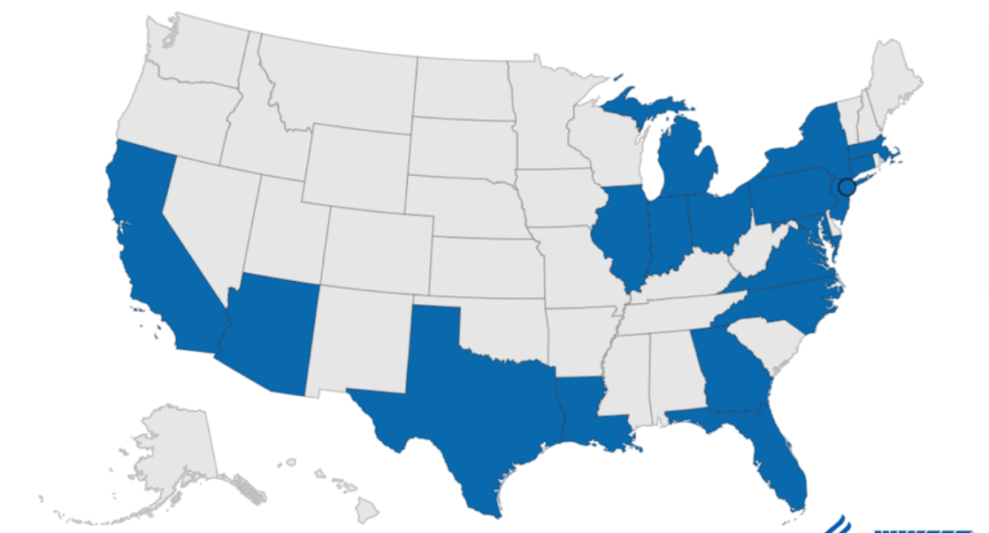
States included in the survey
New York
California
New Jersey
Illinois
Texas
Massachusetts
Florida
Pennsylvania
Michigan
Georgia
Maryland
Virginia
North Carolina
Arizona
Louisiana
Connecticut
Ohio
Indiana

Slide 7
SURVEY
The survey asks questions that helps us asses,
Resilience.
Work changes.
Turnover intent.
Discrimination.
Depression.
Post-Traumatic stress disorder (PTSD).
Burnout.
Psychosocial support systems.
Demographics

Slide 8
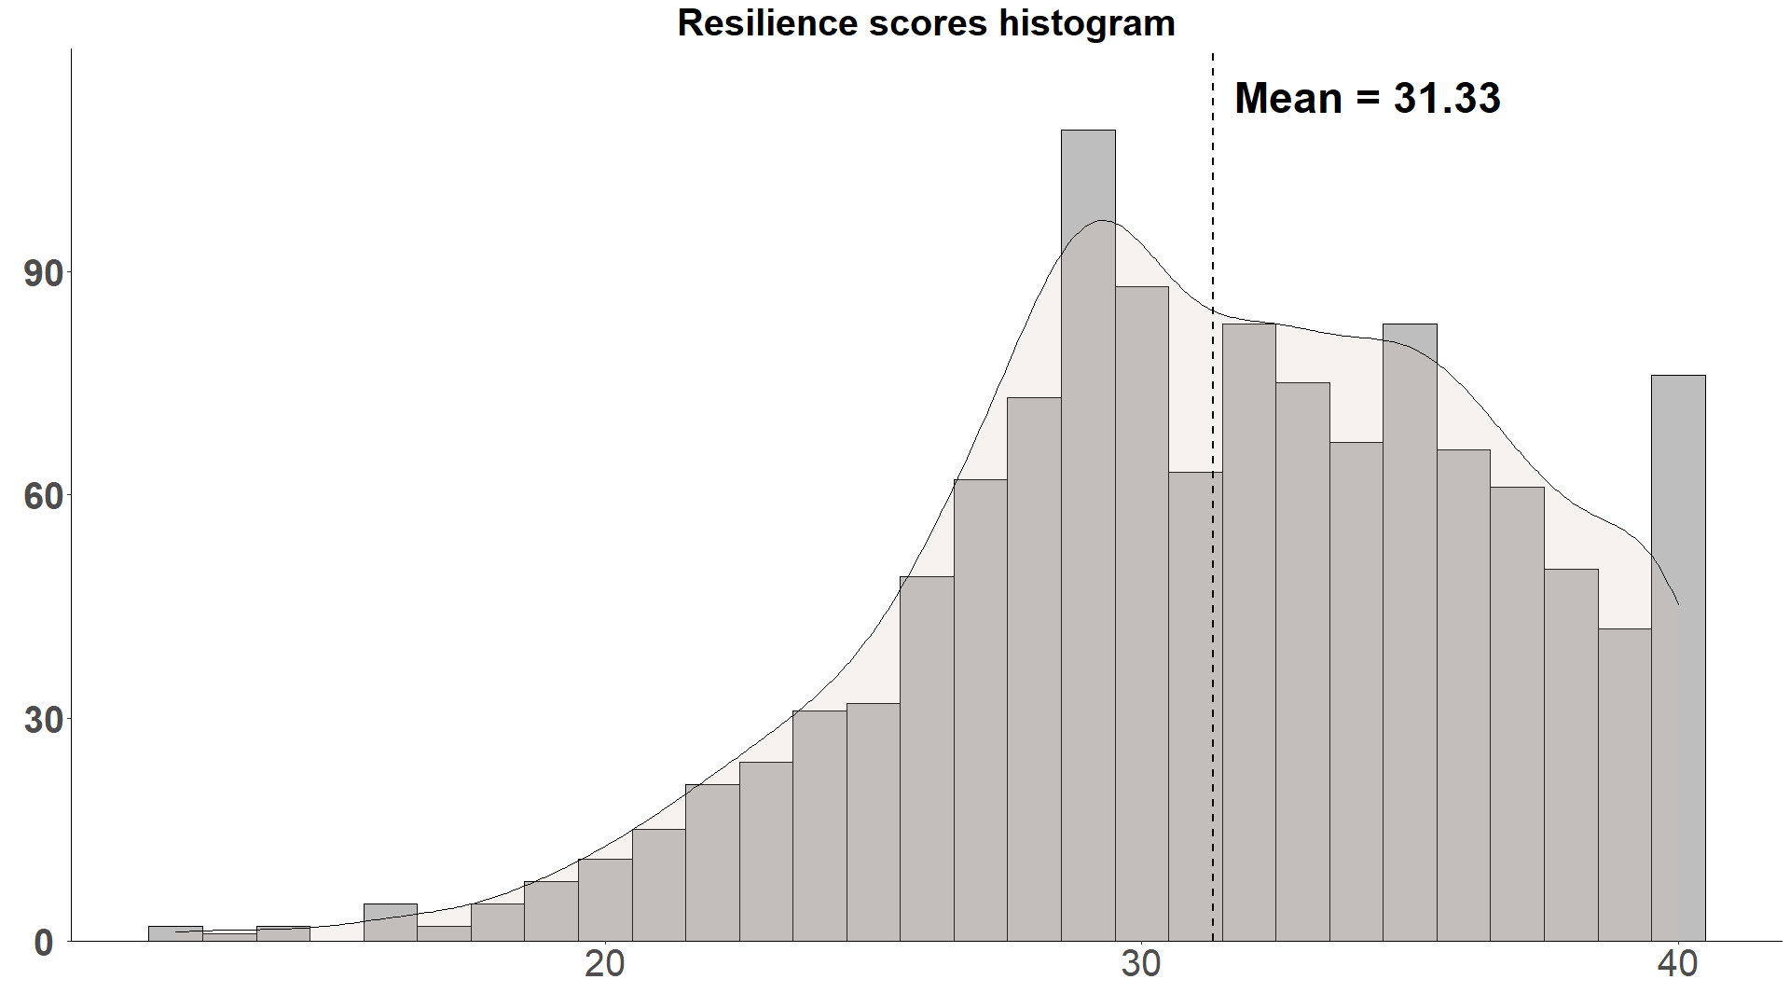
Resilience
Resilience is assessed by 10 questions with 4-point scale each.
The total scores range from 0-40 where 40 means highly resilient and lower score suggests less resilient.

Slide 9
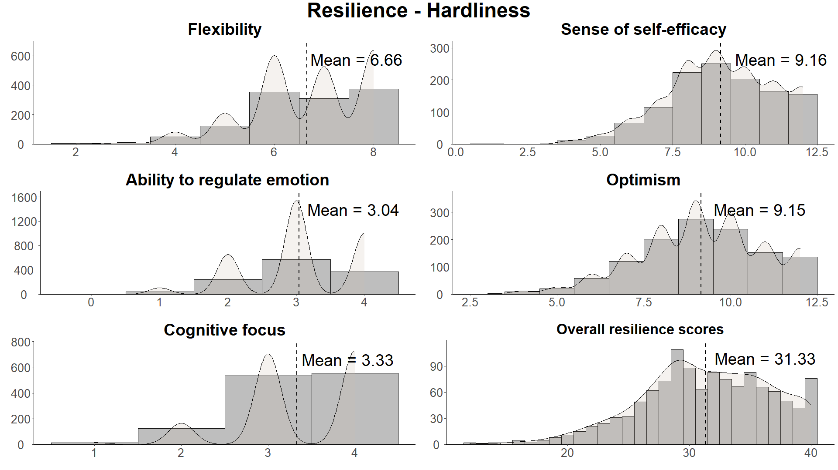
Resilience
The scale serves mainly as a measure of hardiness.
Flexibility.
Sense of self-efficacy.
Ability to regulate emotion.
Optimism.
Cognitive focus/maintaining attention under stress.

Slide 10
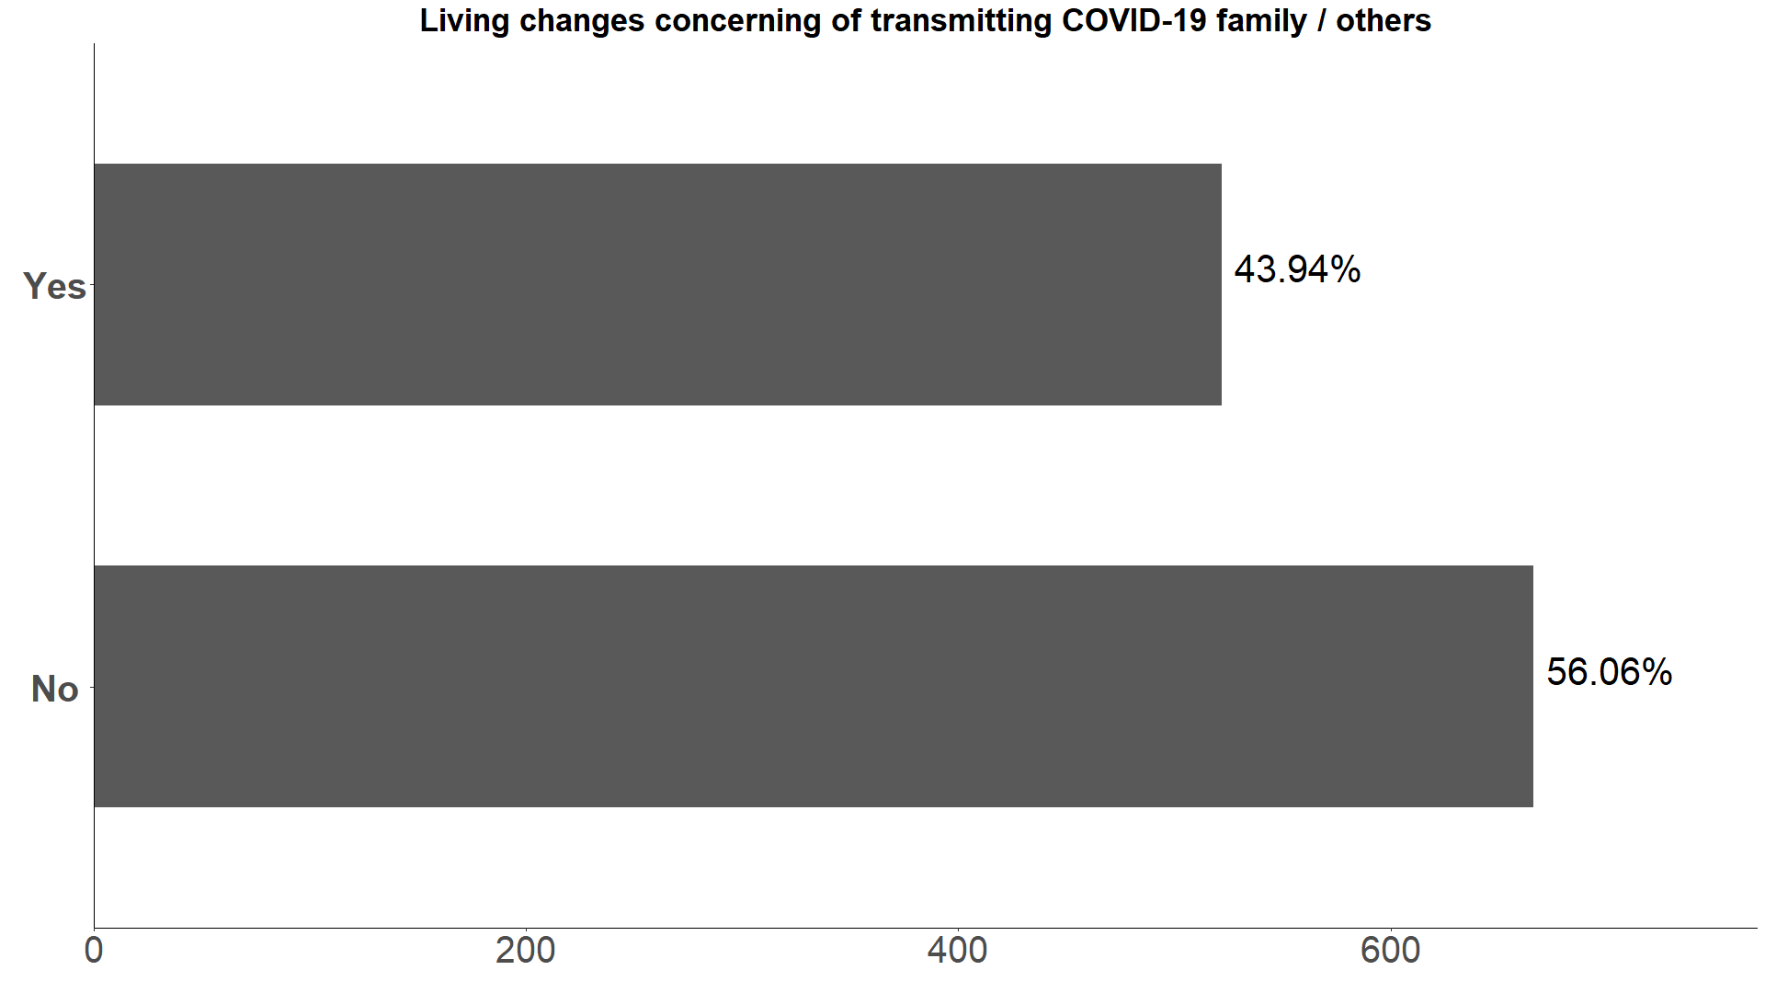
Living arrangement changes

Slide 11
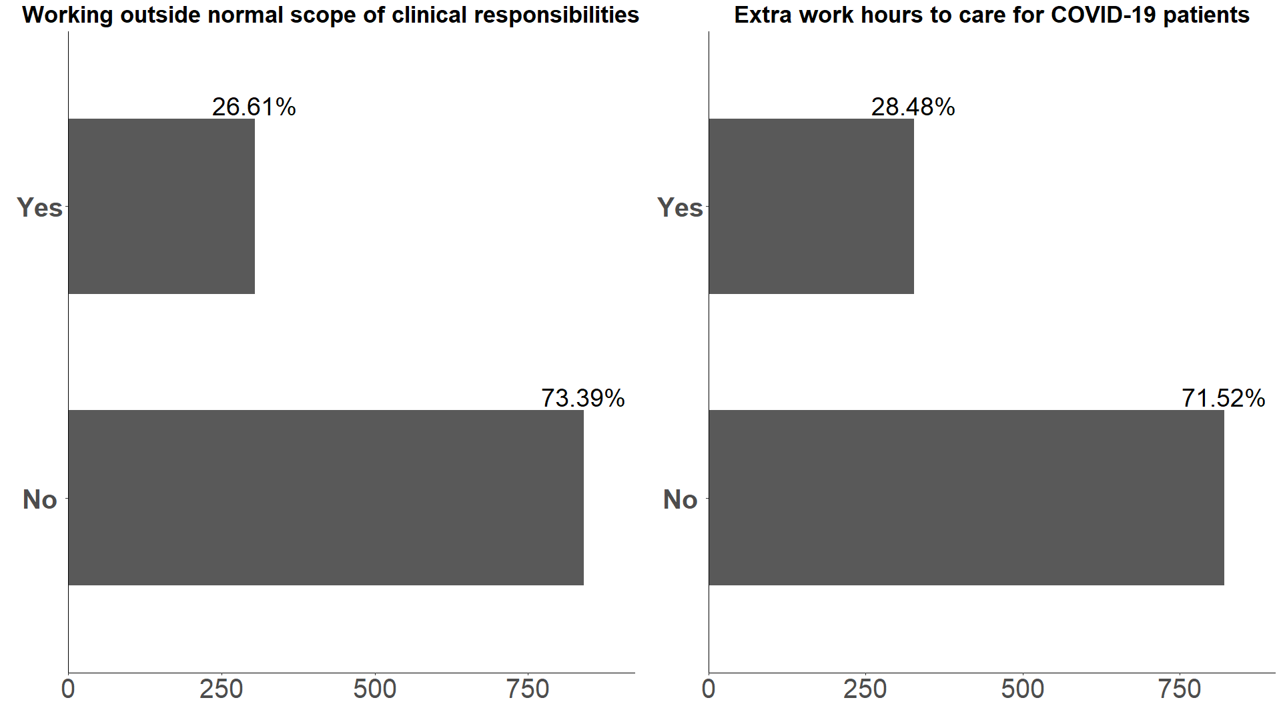
Work-relaed

Slide 12
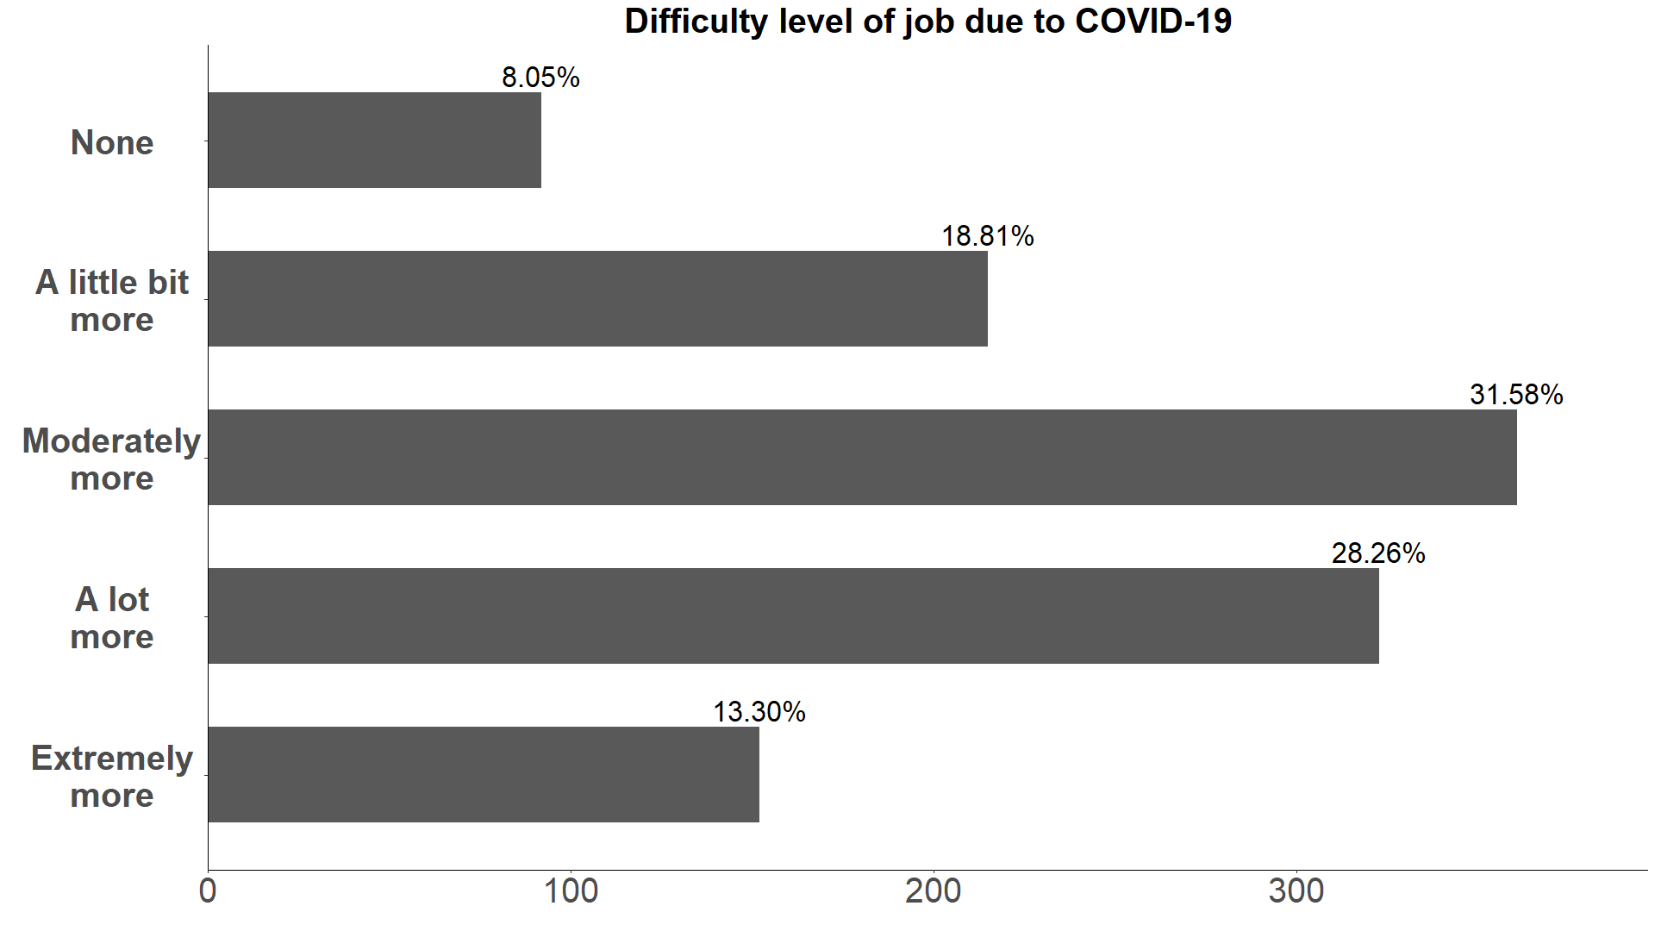
Increase in difficulty of job due to COVID

Slide 13
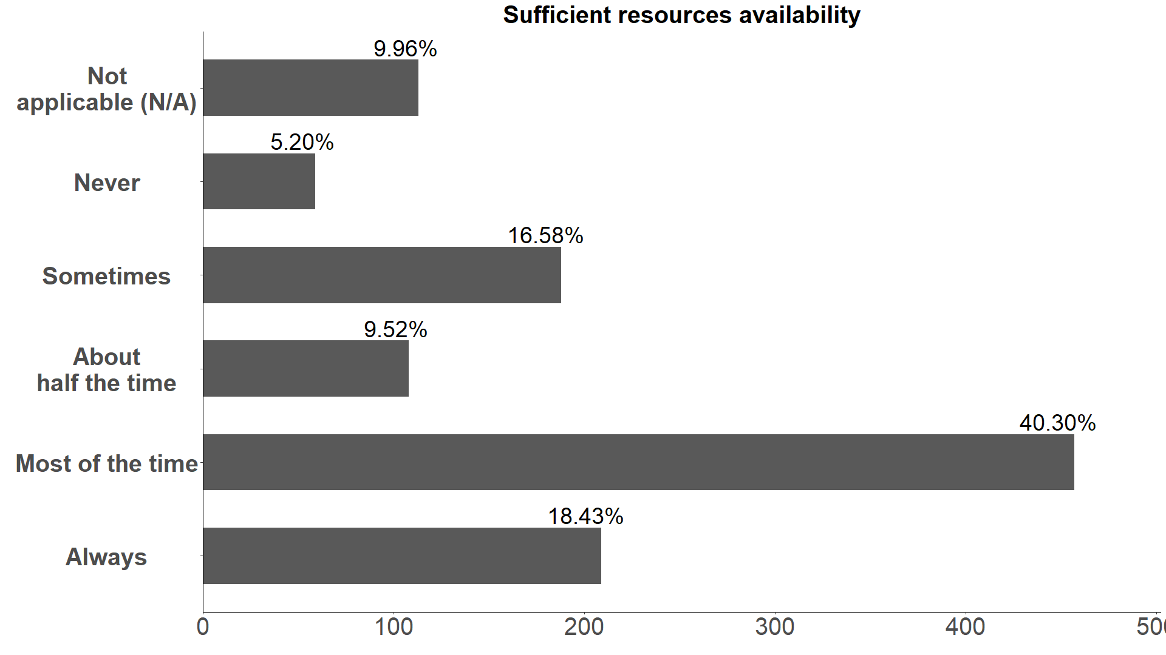
Availability of resources

Slide 14
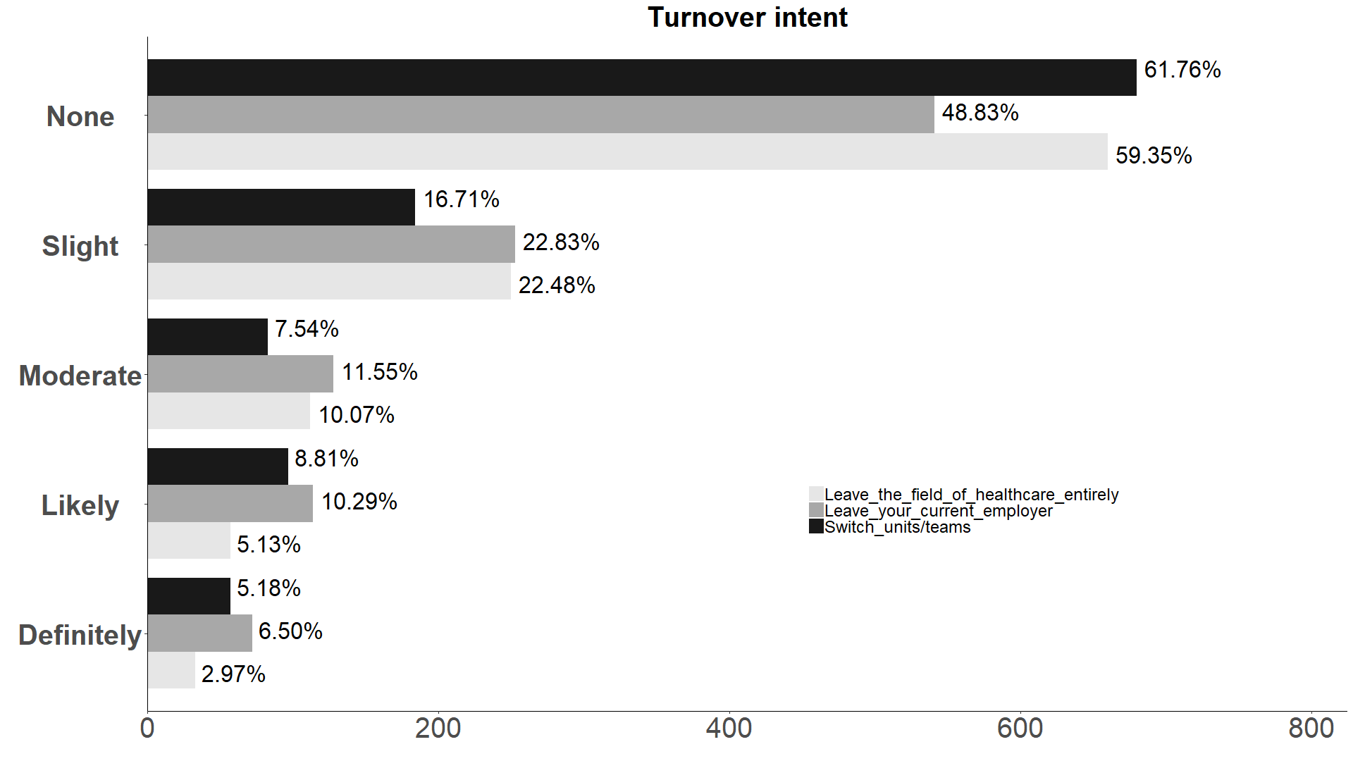
Turnover intent

Slide 15
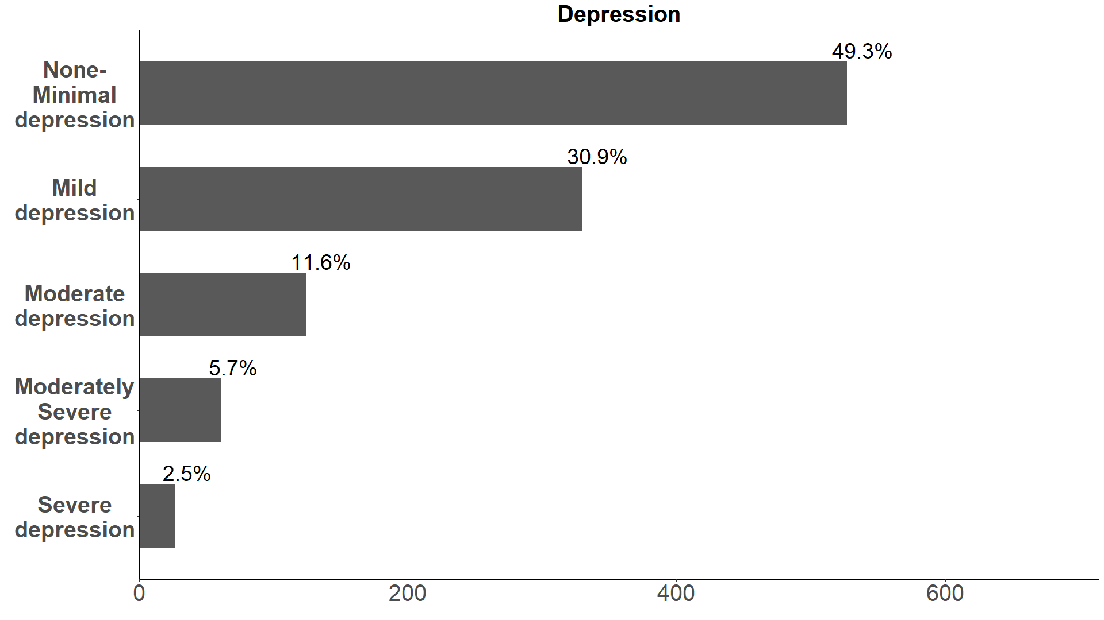
Depression
Depression is assessed by PHQ-9 scale.
Score ranges from 0-27 with scale range from 0 to 3.
Total score from all 9 questions is binned with 5 bins.
Level of depression ranges from,
None-minimal [0-4]
Mild [5-9]
Moderate [10-14]
Moderately severe [15-19]
Severe [20-27]

Slide 16
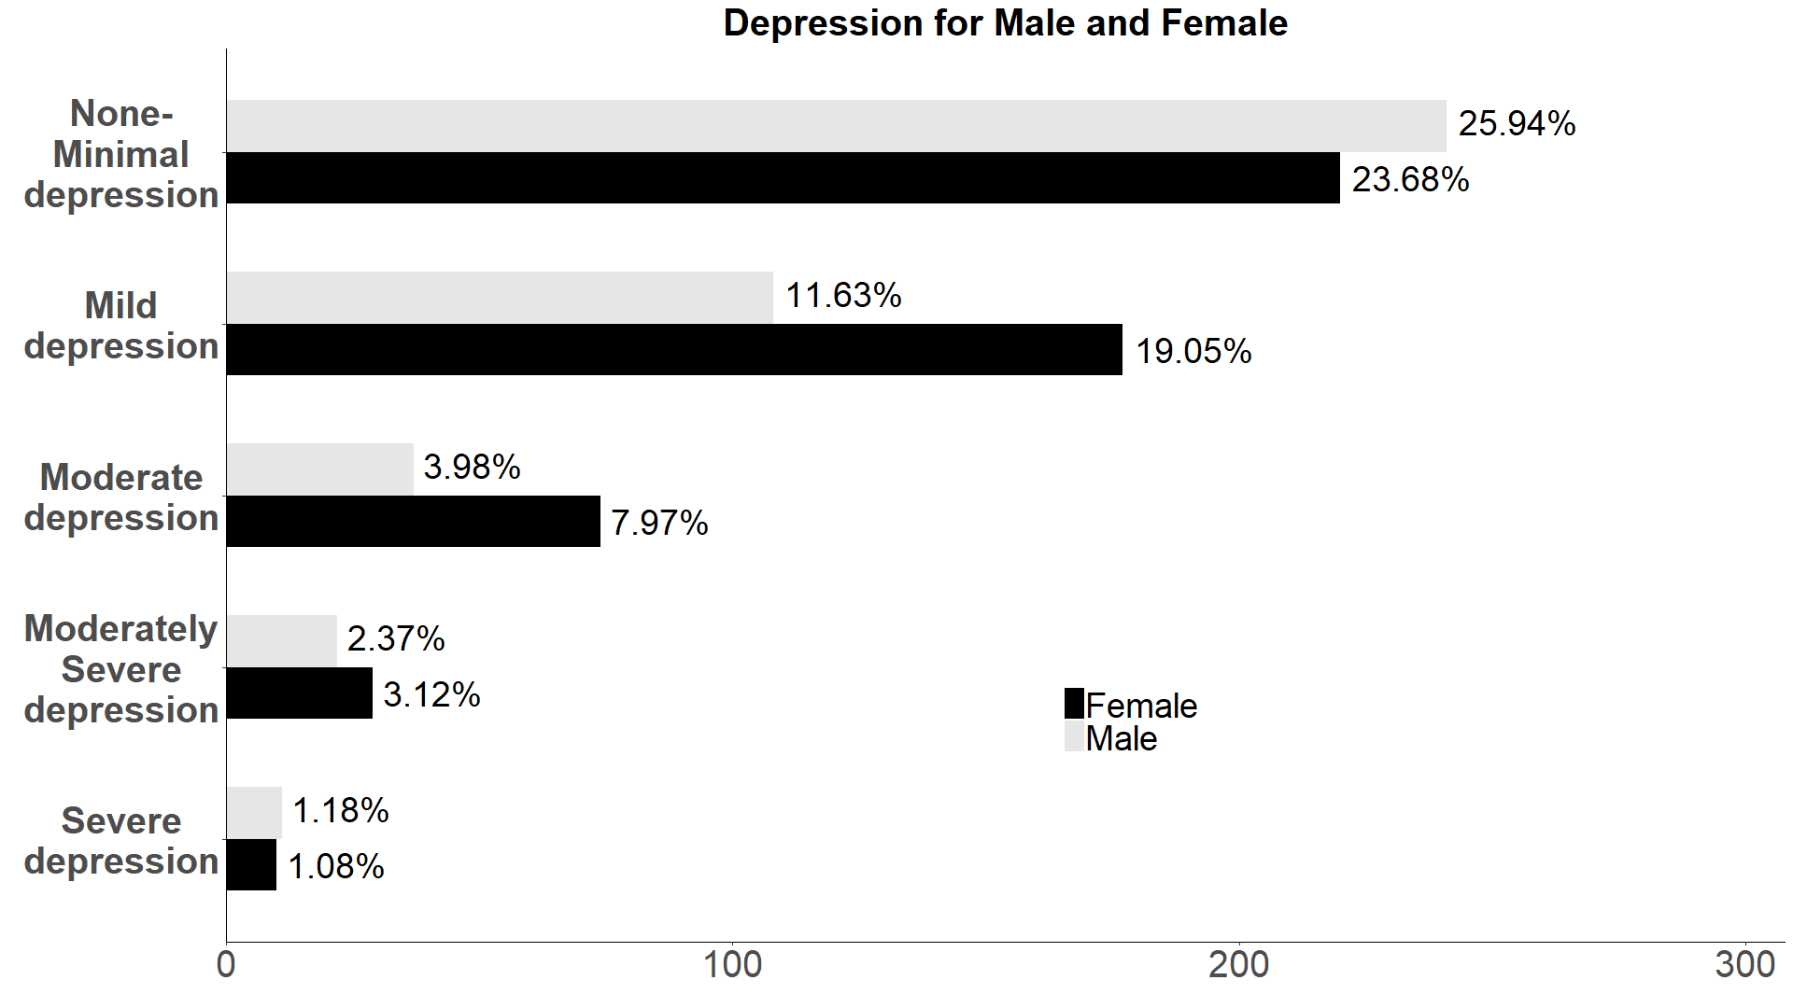
Depression for Male and Female

Slide 17
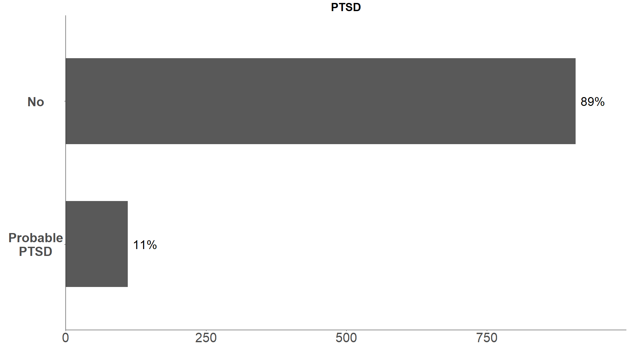
Post Traumatic stress disorder (PTSD)
PTSD is assessed by (PCL-5), 20 questions with each options ranging from 0-4.
Total score ranges from 0-80
Higher score indicates higher chance of PTSD
Cutoff score of 31-33 is indicative of probable PTSD

Slide 18
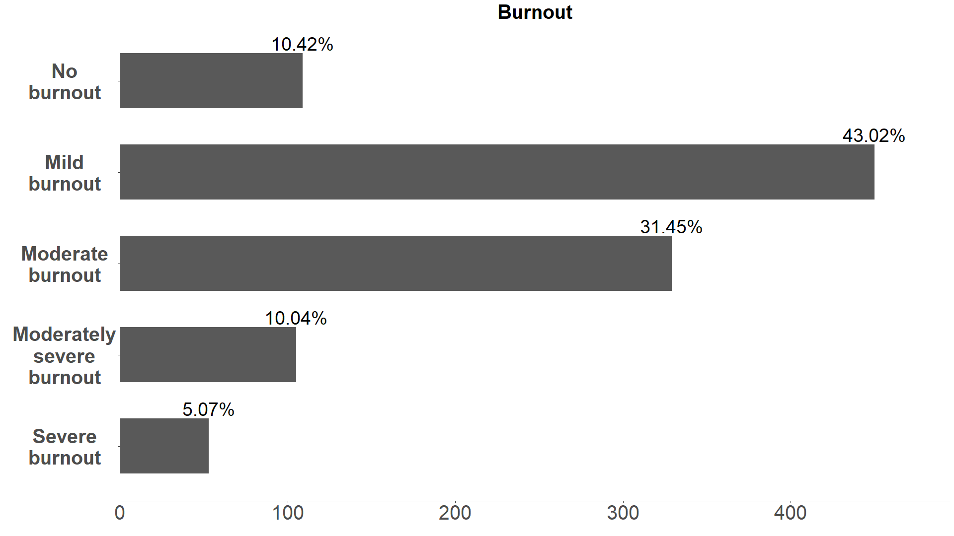
Burnout
Burnout is assessed by single item scale with 5 levels.
The levels are,
No-burnout
Mild-burnout
Moderate burnout
Moderately severe burnout
Severe burnout

Slide 19
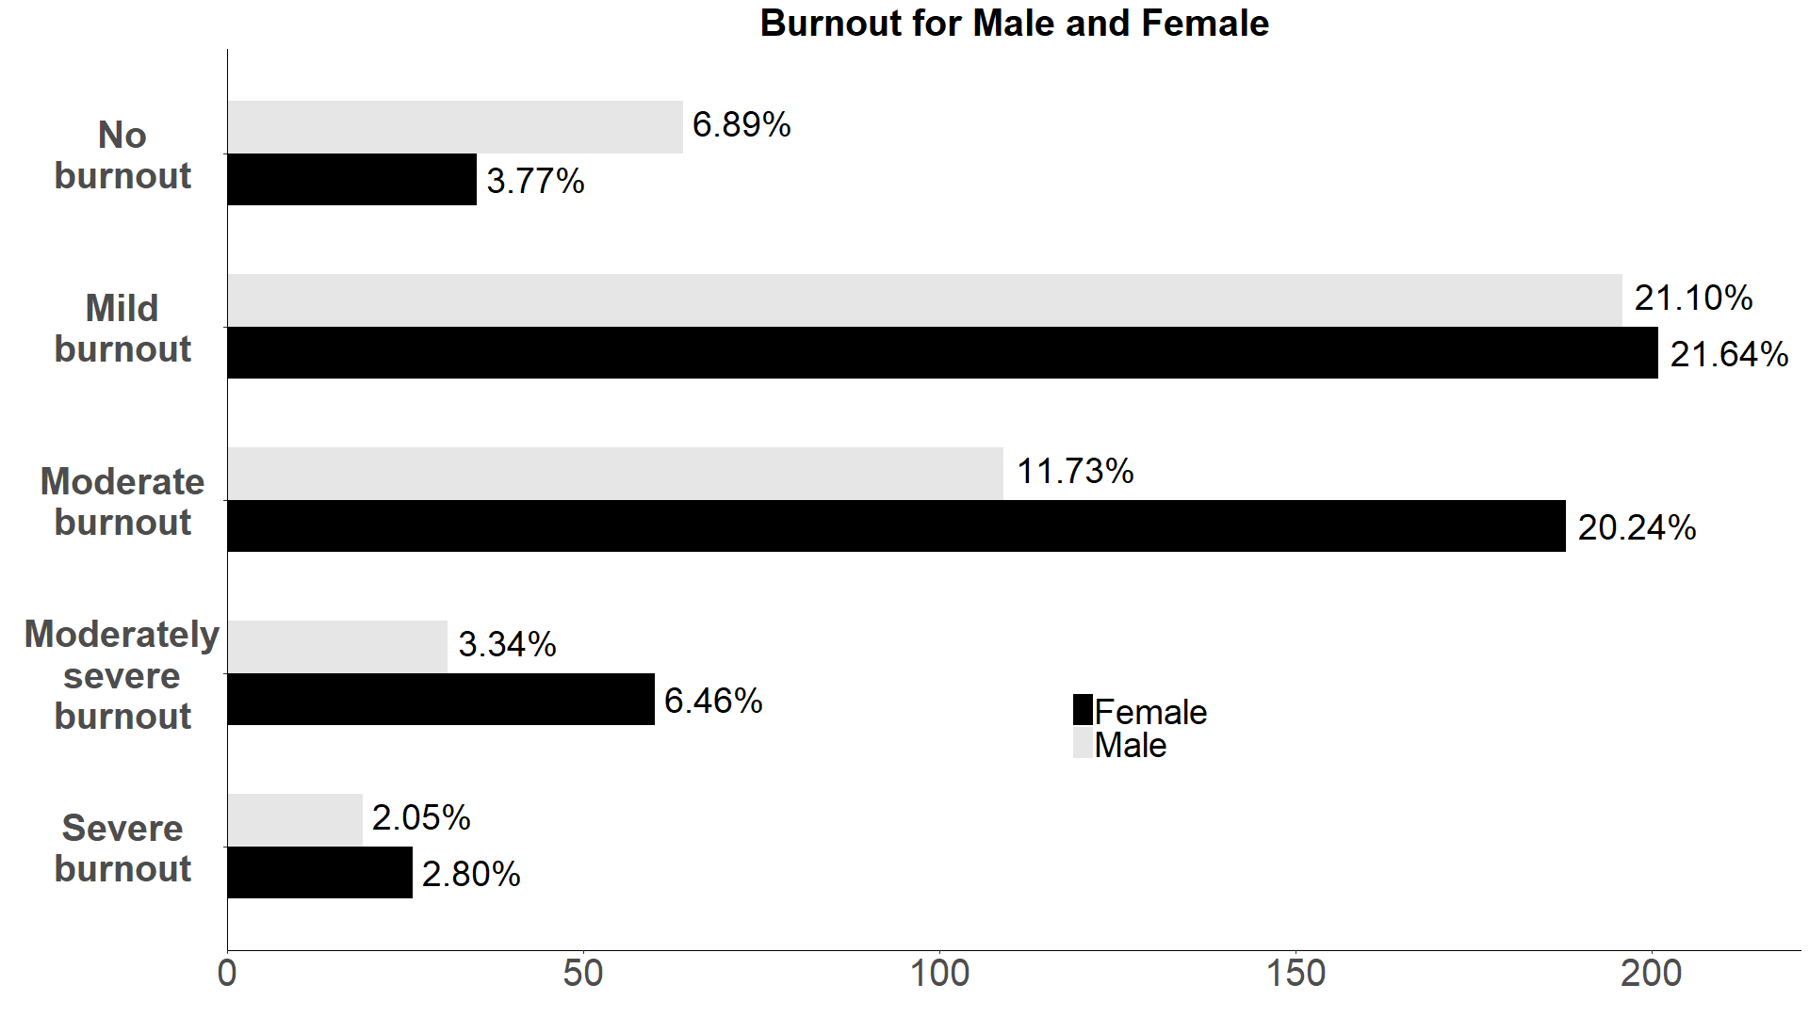
Burnout for Male and Female

Slide 20
Demographics
Age
Sex
Ethnicity – Hispanic/Latino
Immigrant
Relationship status
Years of experience
Primary work setting
Working status
Medical speciality
Race

Slide 21
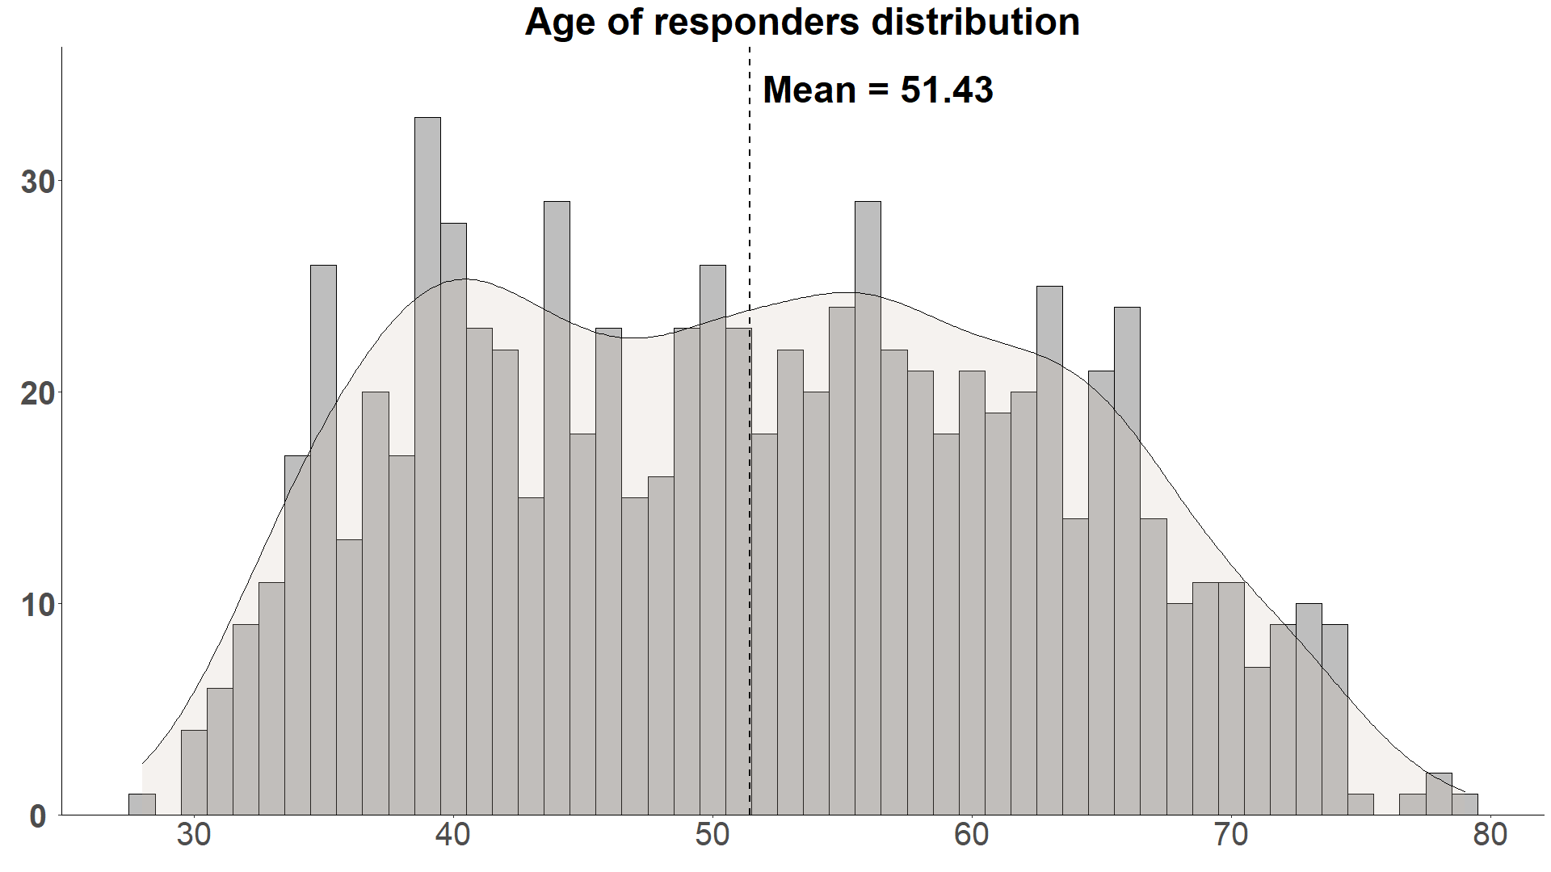
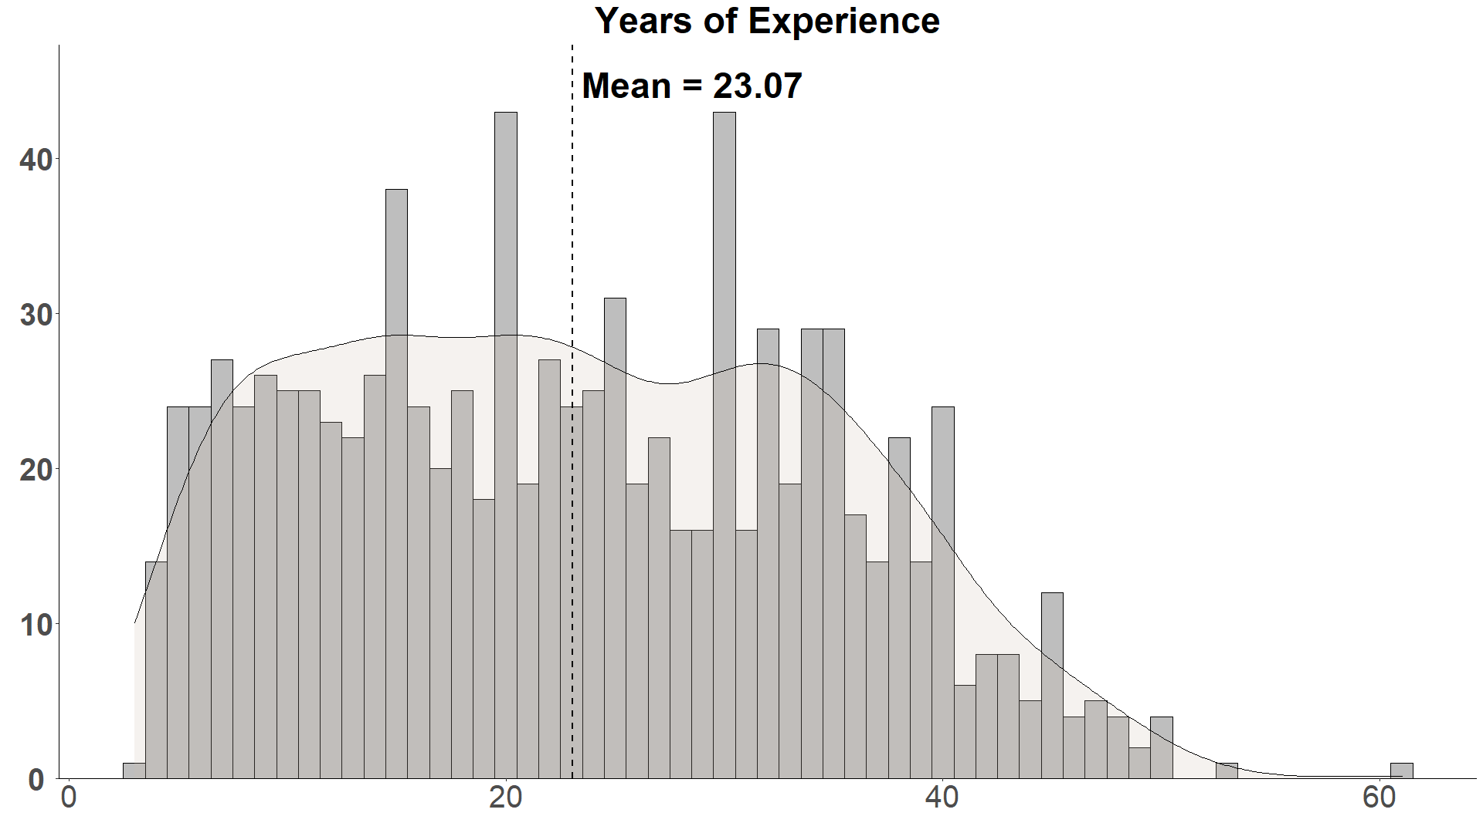
Demographics
Age
Years of experience

Slide 22
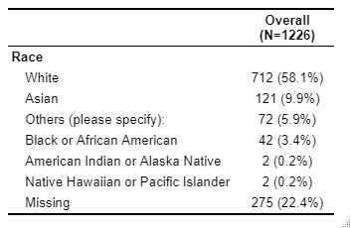
Race

Slide 23
Future work
We are only starting to explore the data, there are a lot to explore in this dataset.
We can categorize all the distributions with respect to demographics and check for patters or trends.
Building a predictive model to understand relationship between variables and find important risk factors that contribute to higher depression/stress levels.

